Slide 1
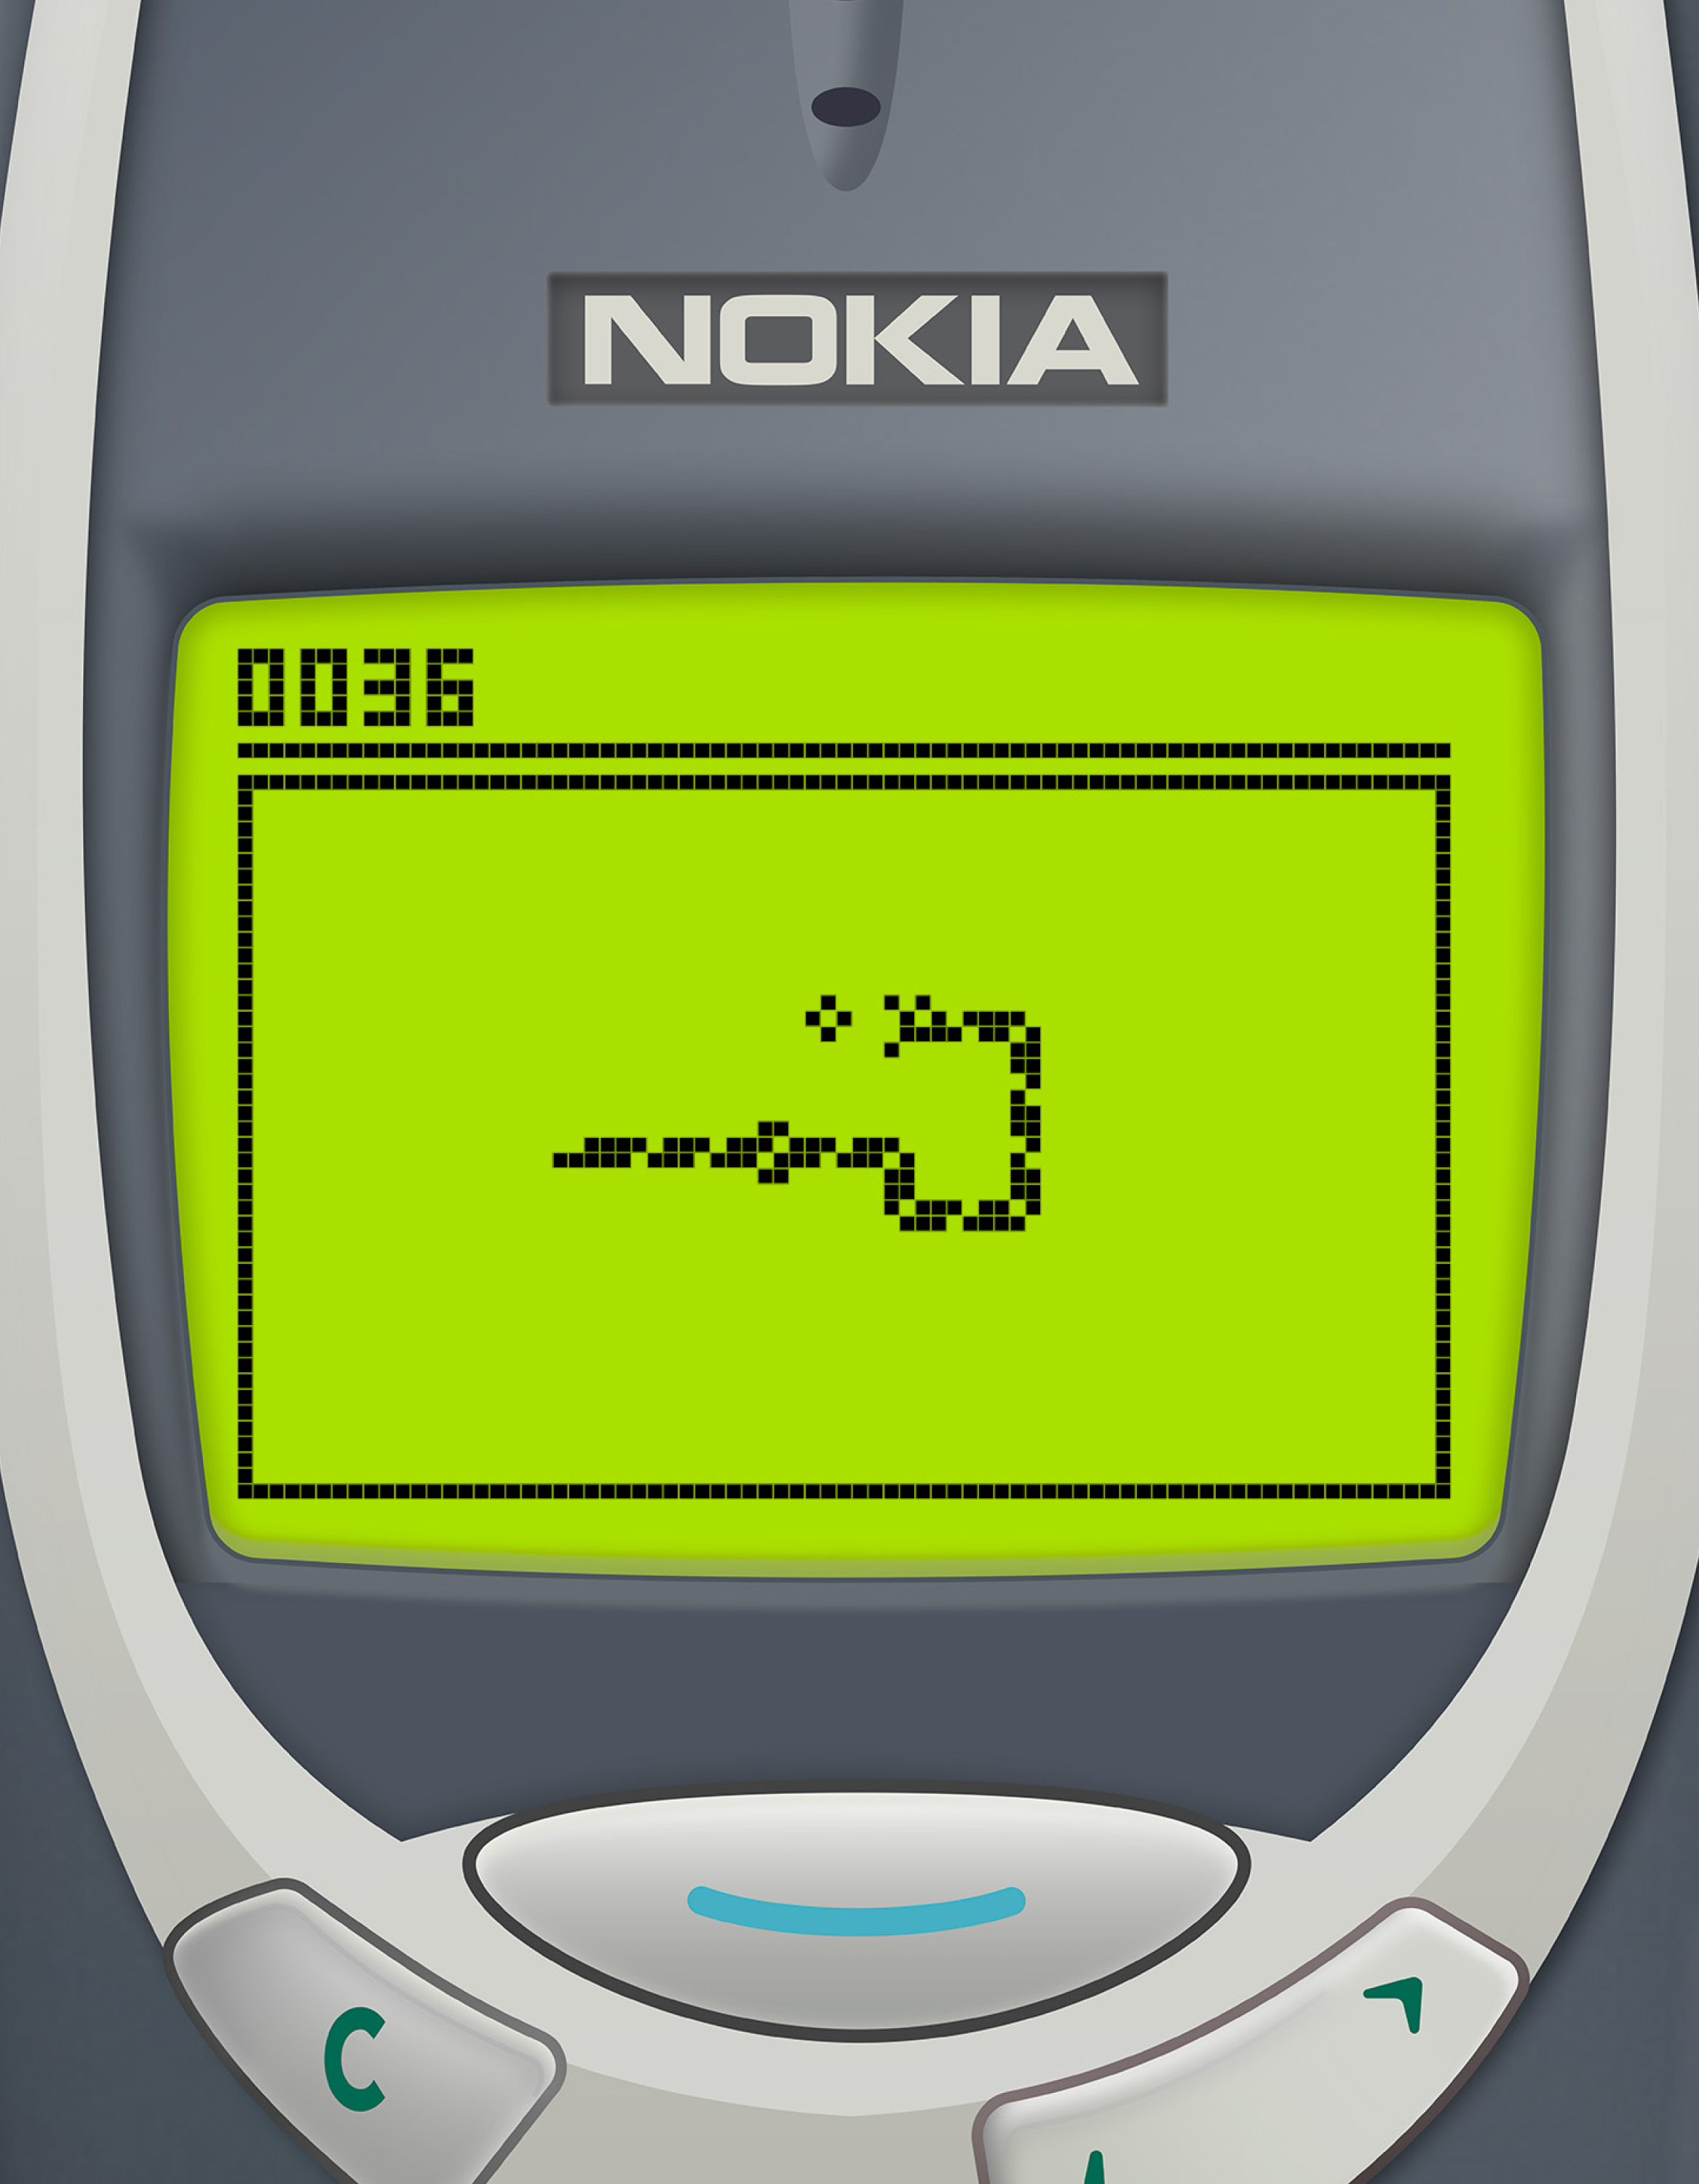
Virtual Snake Game
Presented by:
Ishani Cheke
Shounak Powar​

Slide 2
Introduction
What is Gesture-Controlled Gaming?
Human-Computer Interaction (HCI) is evolving beyond keyboard/mouse.
Gesture control enables intuitive, contactless interaction.
Our project leverages this by applying it to a globally familiar game: Snake.
Goal: Replace traditional inputs with real-time hand gestures using a webcam

Slide 3
Problem Statement and Objectives
Statement:
Creating a traditional Snake game controlled entirely through real-time hand gestures instead of physical input devices.
Objectives:
Design a gesture-controlled interface using webcam input to detect hand movements.
Maintain the core mechanics of the original Snake game: continuous motion, food collection, collision detection.
Ensure real-time responsiveness with minimal latency between gesture and game response.
Enhance user experience through smooth input filtering, dynamic obstacle generation, and adaptive screen scaling.

Slide 4
Game Mechanics
The game follows the core structure of the classic Snake game—eat food, grow in length, avoid collisions.
The snake moves continuously in its current direction and only turns when a valid gesture is detected.
Directional input is controlled by swipe-like movements of the index finger (left, right, up, down).
Every food item consumed increases both the snake’s length and the player’s score. The difficulty increases as the snake grows, making navigation more challenging over time.
Collisions with the screen boundaries, the snake’s own body, or obstacles result in a game-over state.

Slide 5
Tools & Libraries Used
Python 3.x - Core programming language
OpenCV - Frame capture, preprocessing, visual overlays
CVZone - Real-time hand landmark tracking (21 points)
NumPy - Array and vector math for gesture smoothing
Random - Used to generate food positions at random screen locations, ensuring unpredictability and replicability.
Math - Performs vector math, distance calculations, and angle measurements for gesture direction tracking.

Slide 6
System Architecture
Capture Module : Uses OpenCV (cv2.VideoCapture) to read live video frames.
Gesture Detection Module : Uses CVZone to track hand landmarks to extract the index finger position
Processing Module : Compares current and previous positions to infer gesture direction and validates gestures using thresholding and filtering logic
Game Logic Module : Updates snake position, handles food generation, scoring, and collisions
Rendering Module : Uses OpenCV drawing functions (cv2.circle, cv2.rectangle, cv2.putText) to display game state.

Slide 7
Gesture Detection Pipeline
Index Finger as the Directional Controller :
Flipped Webcam Feed
CVZone’s Handetector
Detect landmark 8 (index fingertip)
Calculate Delta Frame by Frame
If Motion exceeds axis specific threshold
Direction Change is Triggered

Slide 8
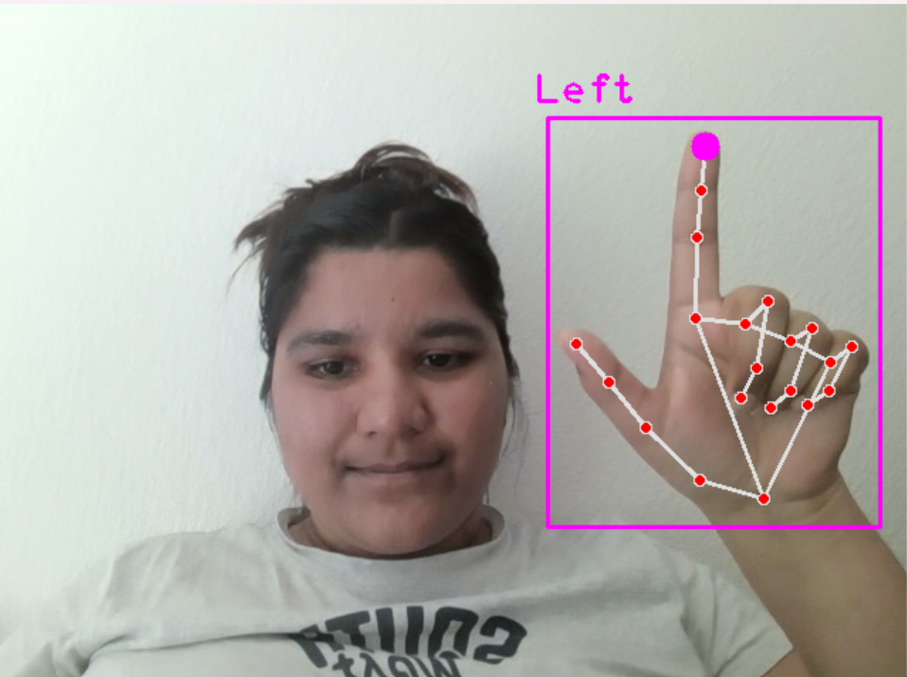
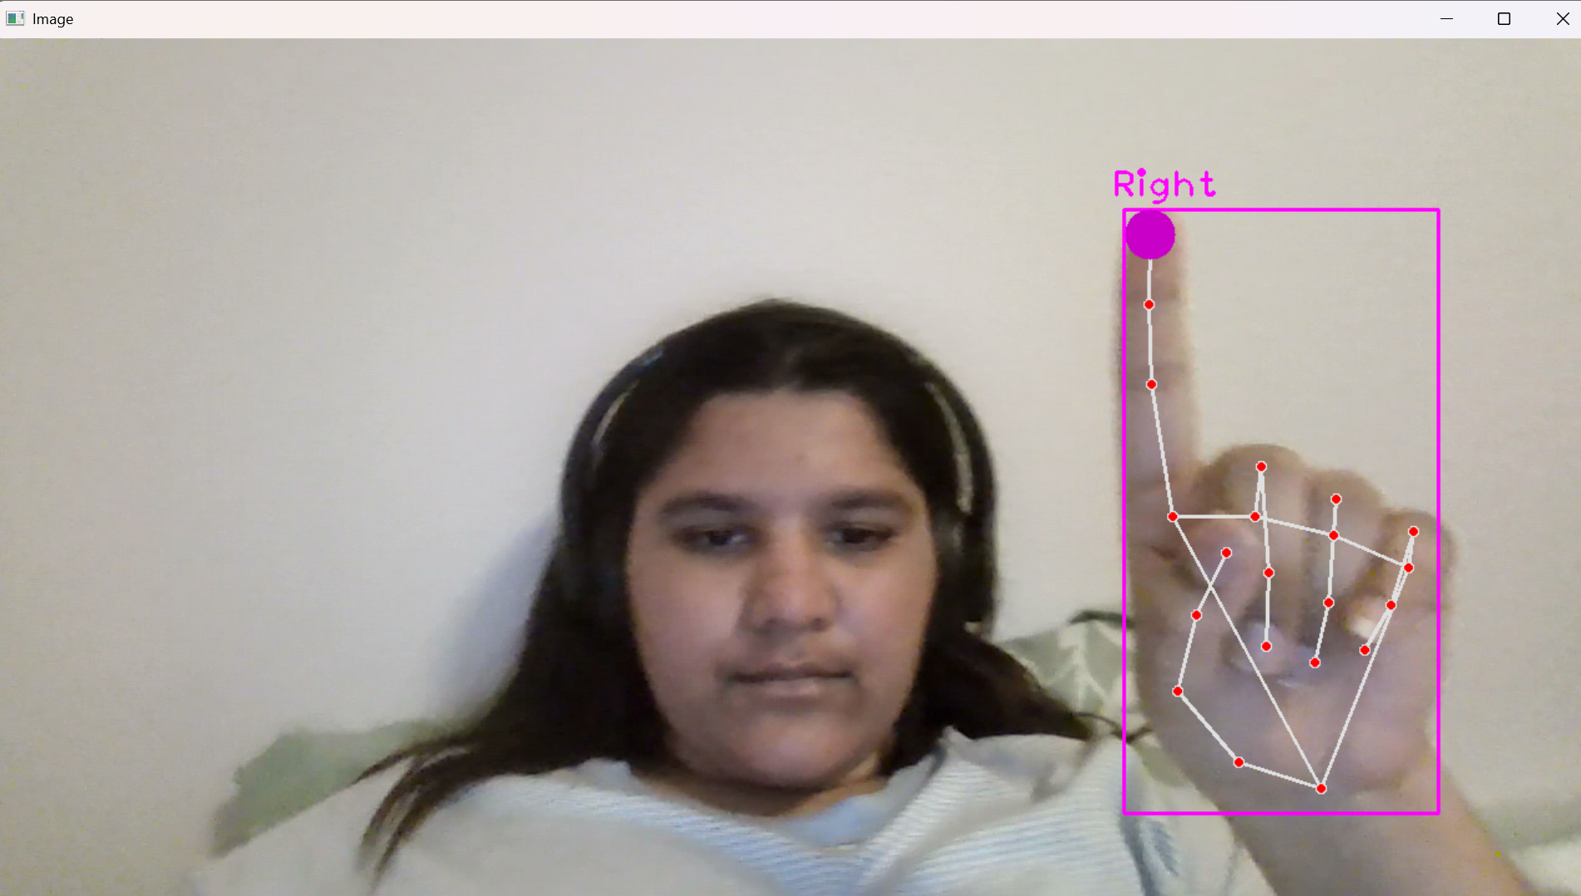
Setting up Gesture Detection
Mirrored Version Flipped Version with Index Finger

Slide 9
Food Consumption
A preloaded image is used to visually represent food on the screen.
The food is placed at a random(x,y) position within the game frame using Python’s (random.randint()) function.
In each frame, the system checks if the distance between the snake’s head and food falls below threshold using Euclidien distance formula:
distance = math.hypot(food_x - head_x, food_y - head_y)
if distance < threshold:
food_eaten = True

Slide 10
Snake’s Growth
If the food is considered “eaten”:
* A new food location is generated
* The snake’s score is incremented
* The snake’s length is increased by appending a new segment to the snake_list.
snake_list = [[x1, y1], [x2, y2], ...]
A new head segment is added to the front of the list.
If food wasn't eaten, the last segment (tail) is removed.
If food was eaten, the tail is not removed, causing the snake to grow.
This logic ensures a consistent update loop while smoothly growing the snake based on interaction with the food image.

Slide 11
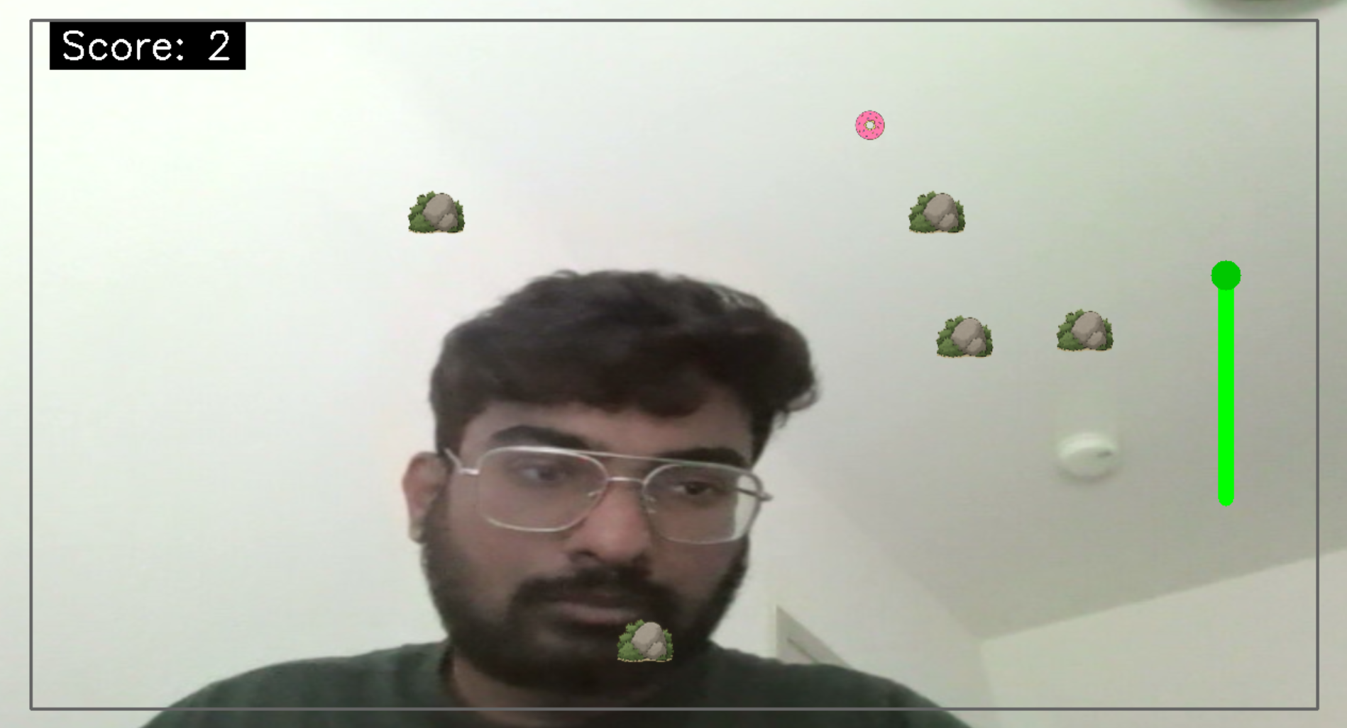
Score & Length Tracking

Slide 12
Collision Detection
At each frame update, the game checks for possible collisions between the snake's head and other elements.
Self-collision: If the snake’s head overlaps any part of its body, the game ends.
Boundary collision: If the snake moves beyond the edges, the game terminates.
Obstacle collision: In enhanced modes, the game includes static obstacles, and hitting any of them triggers a game-over state.
These checks are performed using coordinate comparisons between the snake’s head and other entities on the screen.
On collision, a game-over flag is set, and OpenCV displays the final score with a message overlay.

Slide 13
Challenges & Solutions
Hand jitter and noise were common during input; solved using thresholding and gesture smoothing filters.
Lighting variation affected hand detection quality; resolved through background-independent hand tracking in CVZone.
Gesture inconsistency across users (size, speed, range) was mitigated using adaptive margins and single-point tracking (index fingertip).
Real-time responsiveness was preserved by using lightweight libraries (OpenCV + CVZone) and keeping rendering efficient.
Sudden reversals risked self-collision; disallowed through direction validation logic.

Slide 14
Application and Future Scope
Applications:
The core gesture tracking system has potential applications in contactless public systems, assistive technology, and VR/AR environments.
Users with limited mobility can benefit from gesture-based controls as an alternative to traditional input devices.
Future development can include:
Dynamic difficulty modes.
Multiplayer extensions and interactive leaderboard systems

Slide 15
Conclusion
This project reimagines the classic Snake game using a gesture-controlled interface, replacing keyboard input with natural hand motion.
Real-time hand tracking powered by CVZone enabled precise, intuitive control through the webcam.
OpenCV was used not only for capturing input but also for rendering the game environment without any game engine dependency.
We successfully demonstrated a functional, immersive, and scalable human-computer interaction model.

Slide 16
Thank You !!

